Slide 1
Hooks

Slide 2
Hooks are one of the most powerful features in React.
They were introduced in React 16.8 to let us use state and lifecycle methods inside functional components — without writing a class.
Before hooks:
Functional components were stateless.
We used class components for state & lifecycle.
After hooks:
Functional components can now manage state, handle side effects, and reuse logic easily.

Slide 3
What is a Hook?
A hook is a special function provided by React.
It lets you "hook into" React features like state, lifecycle, context, refs, etc.
Hooks must start with “use” (e.g., useState, useEffect).
Rules of Hooks:
Only call hooks at the top level of your component (not inside loops/conditions).
Only call hooks from:
React function components
Custom hooks

Slide 4
Commonly Used Built-in Hooks
useState
useEffect
useRef
useReducer
useMemo
useCallback
useLayoutEffect
useContex

Slide 5
useEffect Hook
If useState is for managing state, then useEffect is for managing side effects in React.
A side effect means any code that affects something outside React’s render cycle.
Examples:
Fetching data from an API
Setting up event listeners (like resize, scroll)
Working with timers (setInterval, setTimeout)
Updating the browser’s DOM or title manually

Slide 6
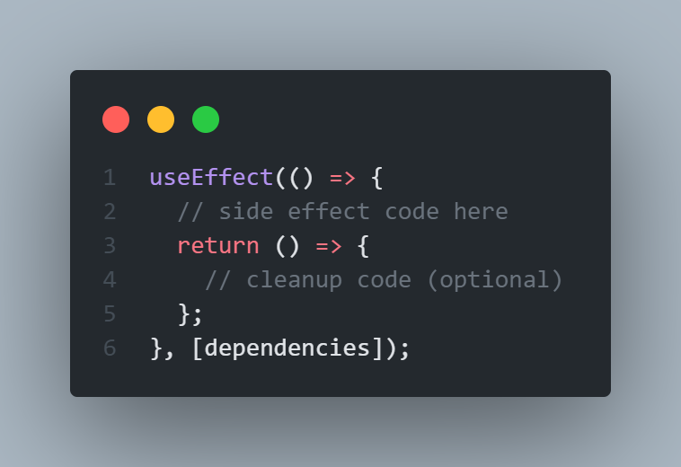
Normally, React components should only return UI, but side effects let us interact with the outside world.
useEffect is a React hook that lets us perform side effects in functional components.

Slide 7
Thank You

